Slide 1

2025 Diocesan Proposed Budget
Notes:
Bishop to introduce with prayer

Slide 2

2025 Budget Focus
We expected 2025 to be a year of new initiatives and opportunities due to generous giving in our parishes.
Market performance this year is expected to be steady. A 4% increase is expected, covering the annual distributions.
Notes:
Bishop/Carol
Opportunity/New Initiatives Budget Year
We are seeing an increase in Parochial Report revenue.

Slide 3
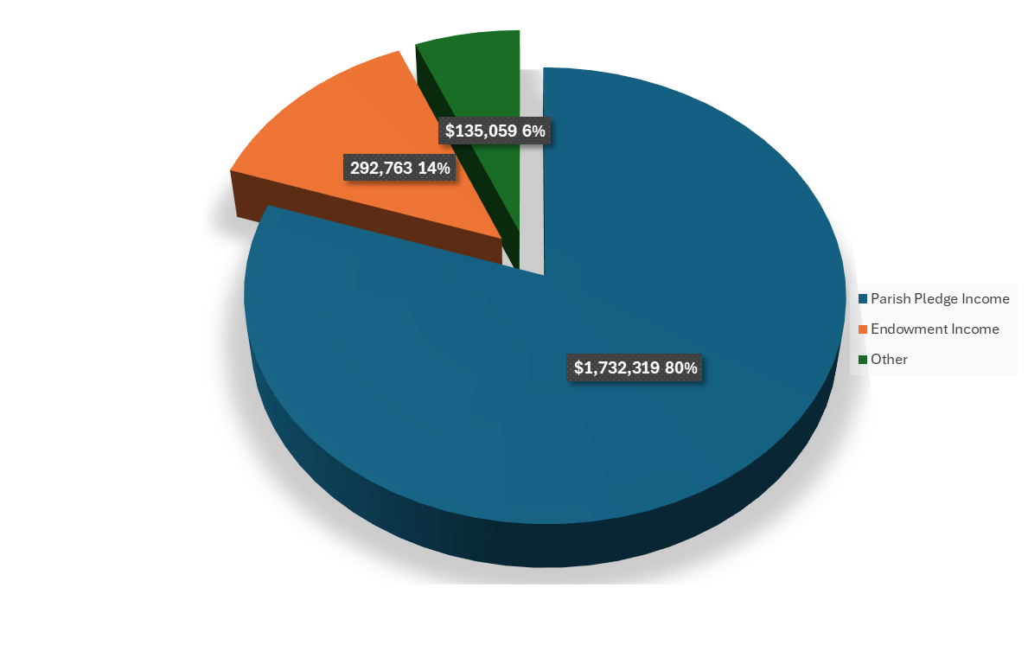
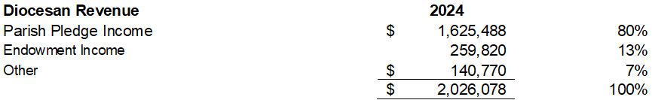
2025 Proposed Diocesan Revenue
Notes:
Jack
Emphasize the generosity!
Budget based on 9.78% of 2023 PR operating income 3 yr avg.
Pledge commitments due 10/31
*if pledges are higher (hope they are) additional funds to grants and small parish support

Slide 4
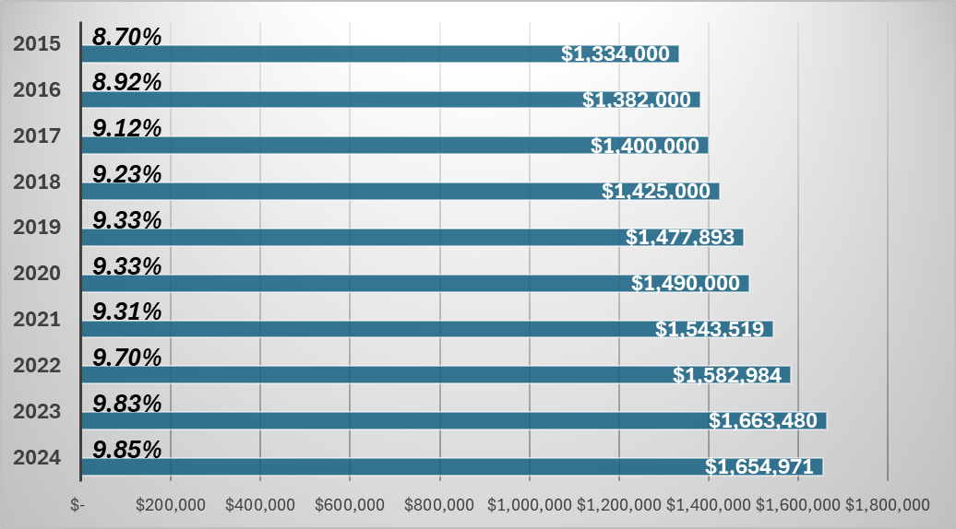
Parish Pledge Income
Notes:
Jack
Amazing the generosity. Churches revenue was down based on 2022 PR but pledging % was up from 9.83% to 9.85% for 2024!!!!!

Slide 5

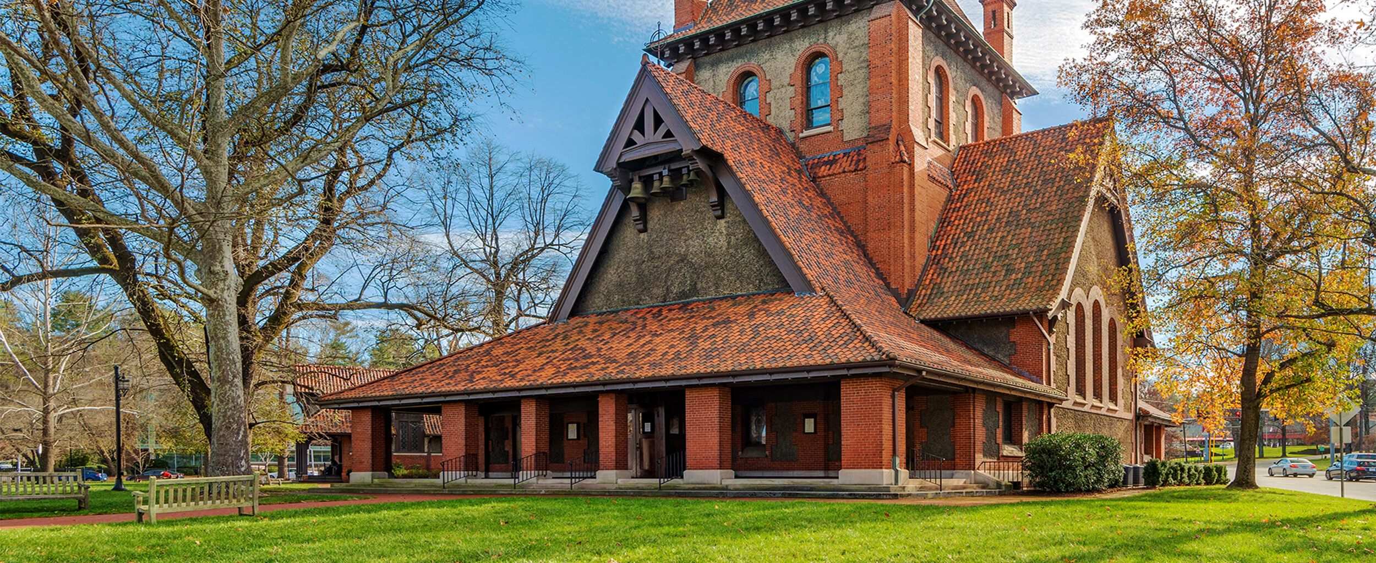
Parish Pledges
2025 Budget: $1,732,319 (9.78%)
If all Parishes gave at 10%: $1,777,129
Notes:
Jack
Bishop’s wish is for all to give 10% and we can fund/support additional programs and grants
That would be an additional 44,810!
2024 Budget is based on 9.78% which is the 3-year average - conservative

Slide 6
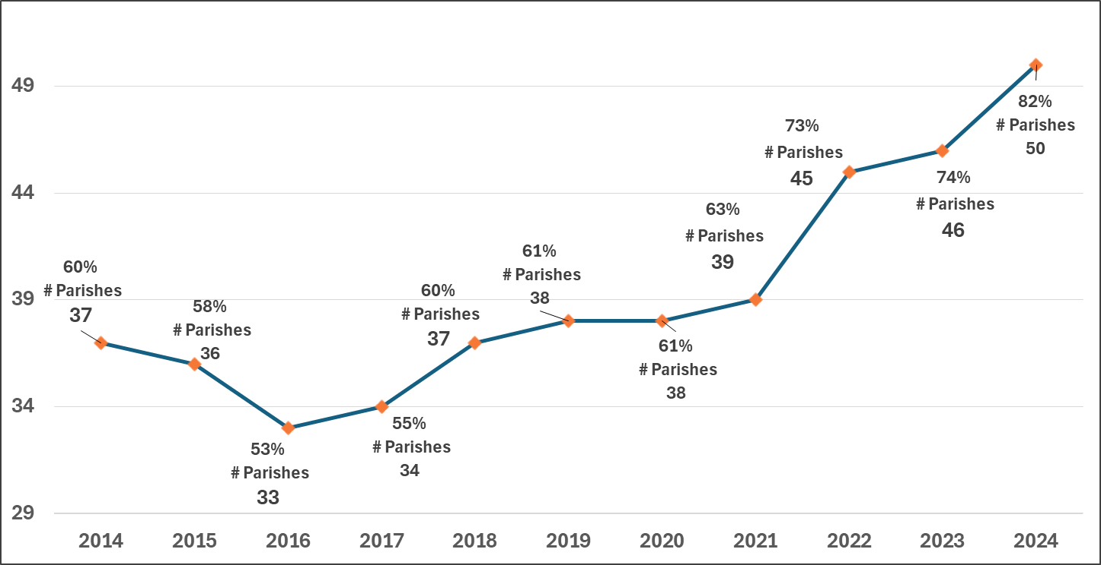
Parishes Giving 10% NOI or more
Notes:
Carol
2019 and 2020 same levels
2021 up in spite of COVID
2022 WOW jumped to 73% of parishes giving 10%
2023 up to 74%
2024 amazing 50 parishes pledged at 10% level which is 82%

Slide 7

Notes:
Carol
Emphasis on total comp – includes salary, benefit, education, travel
New very part-time position to assist CTO with transitions/events ($15,000)
2% average increase in salary
5% estimated for Health. Actual 2.5% average increase
WE DO A LOT WITH LITTLE STAFF

Slide 8

Diocesan Office Administration
Notes:
Carol
Highlight drop since 2016
2019 – Reviewed all contracts, Decreased Network Support, new telephone contract, reduced banking fees & payroll fees
2020 - Increase Networking/Support costs, upgraded staff equipment
2021 - Covid remote working savings, increase was in Network support – new server and additional security
2022 - Inflation – contract increases
2023 - Costs for fiber Optics approx. $6,000 + $3,000 installation/support
2024 - New telephone system due to carrier elimination
2025 Back to basicis
ALL Staff involved in managing admin costs

Slide 9



2025 Focus:
On-Going Mission
New Initiatives
Grants
Notes:
Segway slide

Slide 10

Programs, Mission & Grants
Represents 56.6% of Pledge Income up from 55.3% in 2024
Notes:
Carol to cover:
Overall costs up $40K
- Ministry Dev up $10K Full yr Curate
- Lifelong Christian Ministries up $3K staff & health
- J&O maintained grant level even w/o HHH earnings to fund
- Increase support to Conference Centers $1K
- Increase to Latino Program costs $6K
Bishop to discuss Vitality increase of $19K
- Diocesan Vitality Initiative $15K
- Stewardship $2K
- Church of the Advocate $3K (no increase for past 7 years)

Slide 11
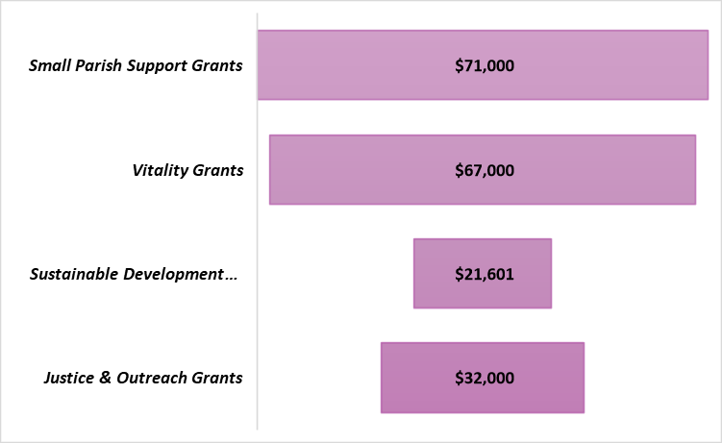

Grants included in Program Budgets
2025 Total $191,601 up from 2024 of $155,271.
These funds are designated for ongoing support to small churches as well as for initiating programs and practices that encourage congregational vitality, growth and mission.
Justice & Outreach income is from operations (parish pledges) now that HHH Fund is exhausted .
Notes:
Carol
Additional pledge dollars will go to grants & programs

Slide 12

Mission Initiatives:
Notes:
Bishop’s slide

Slide 13

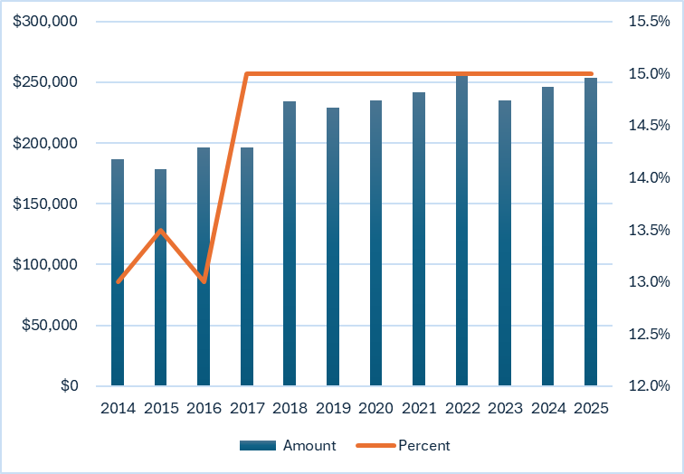
Diocesan pledge to
Notes:
Carol
Highlight prior to 2017
same 15% commitment but two things occurred –
Increase of $7,300 in 2025 as our revenue grows

Slide 14

The Balanced Budget
Notes:
Cash on cash – balanced
Depreciation is the using up of an asset over time (it’s useful life). We fund depreciation through our budgeted reserves

Slide 15


2025 Budget Questions and Answers

